Slide 1
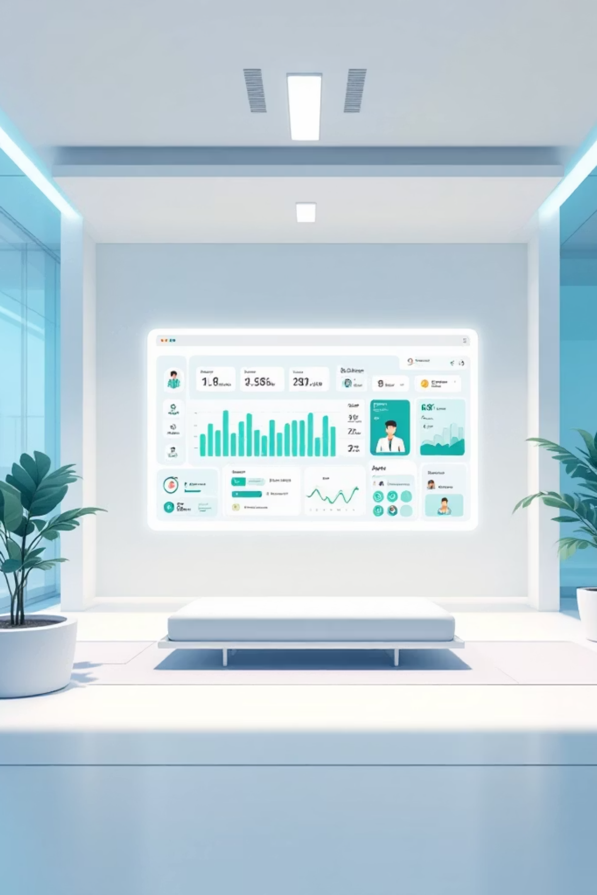
Doctor Appointment System
Django-Based Appointment & Queue Management
[Your Name] | [College Name] | [Date]

Slide 2

Introduction
Healthcare systems face increasing demand for efficient patient management. Digital appointment systems transform traditional manual processes into streamlined, automated workflows that benefit both medical staff and patients.
These systems eliminate paper-based scheduling, reduce administrative burden, and provide real-time visibility into appointment availability. For patients, digital booking means convenience, transparency, and better time management.

Slide 3
Problem Statement
Long Waiting Times
Manual Appointment Handling
Hospitals and clinics experience extended patient queues, leading to frustration and reduced satisfaction
Paper-based systems create errors, double bookings, and scheduling conflicts
Absence of Queue System
Disconnected Updates
No structured token or numbering system causes chaos and confusion in waiting areas
Patients receive no real-time notifications about appointment status or time changes

Slide 4
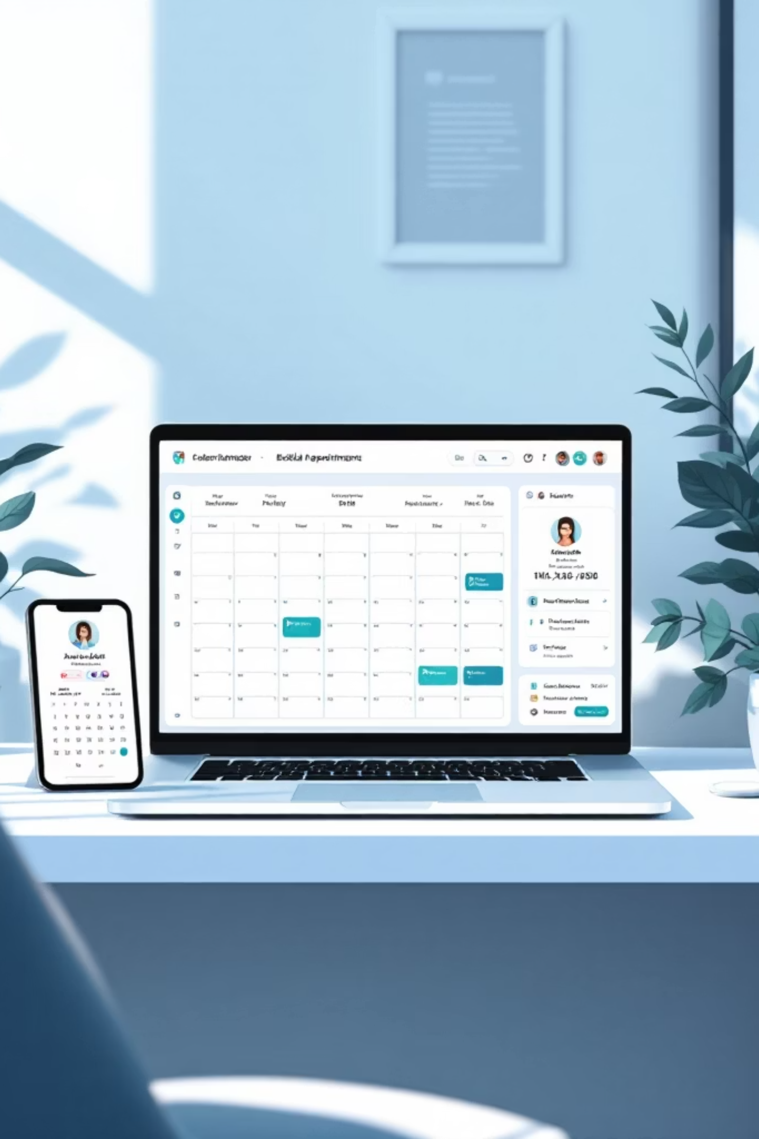




Our Solution
A comprehensive web-based Doctor Appointment System that automates scheduling, manages patient flow, and provides real-time communication between healthcare providers and patients.
Web-Based Platform
Accessible from any device with internet connectivity
Availability Management
Doctors set schedules and patient capacity limits
Smart Queue System
Automatic token generation and waiting time calculations
Email Notifications
Instant confirmation and status updates delivered to patients

Slide 5







System Features
Token-Based Queue
Time Estimation
Availability Scheduling
Automatic numbering system with real-time position tracking
Calculates approximate waiting time based on doctor's schedule
Doctors set working hours, departments, and patient limits
Role-Based Access
Email Alerts
PDF Confirmations
Separate dashboards for doctors and patients with appropriate permissions
Instant notifications for bookings, cancellations, and status changes
Downloadable appointment tickets with all relevant details
Booking History
Complete record of past and upcoming appointments

Slide 6
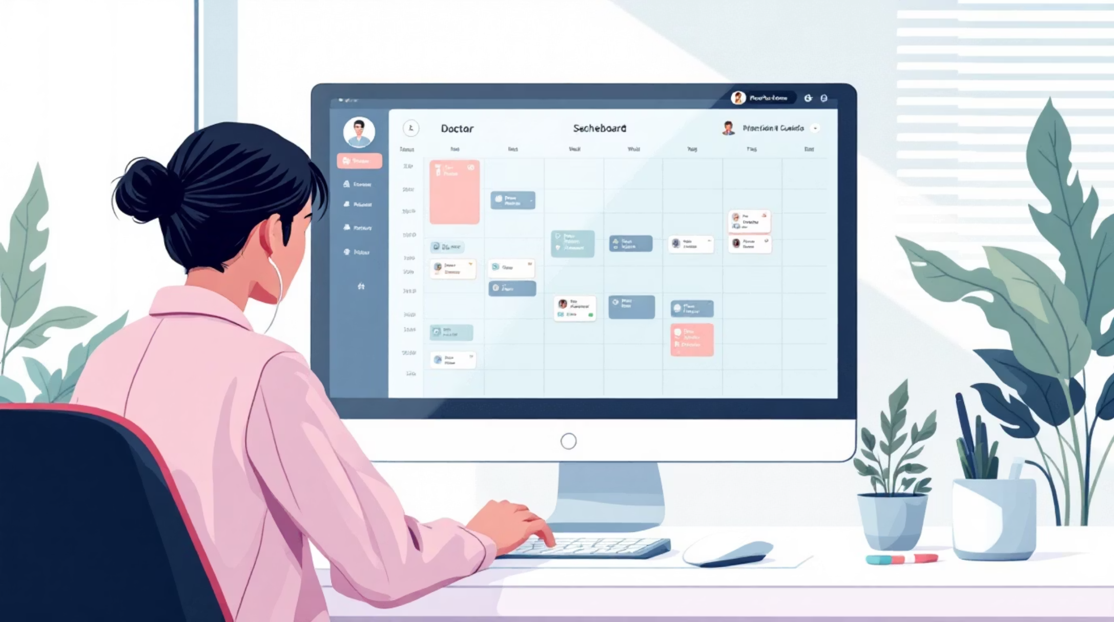
Doctor Module
Key Capabilities
Create availability slots by time and department
Set average consultation duration per patient
View and manage all patient bookings
Update appointment status in real-time
Access patient history and details
Modify schedule based on emergencies

Slide 7





Patient Module
Browse Availability
View available dates and doctor schedules
Book Appointment
Select date, time, and department
Receive Token
Get unique token number and estimated time
Download PDF
Save appointment confirmation
Visit Clinic
Arrive at scheduled time with token
Patients can also view complete appointment history, cancel bookings, and receive email reminders before consultations.

Slide 8
System Workflow
01
02
Doctor creates schedule
Patient books appointment
Define availability, set patient capacity, and specify consultation duration
Choose available slot, select department, and confirm booking
03
04
Token number assigned
Estimated time calculated
System generates unique token based on appointment sequence
System computes waiting time based on doctor's average minutes per patient
05
06
Email confirmation sent
Patient visits based on token
Patient receives instant notification with token, time, and location details
Arrive at clinic, check in using token, and wait for consultation

Slide 9

Technology Stack
Backend Framework
Django (Python) - Robust web framework for rapid development with built-in security features and ORM support
Frontend Technologies
HTML, CSS, JavaScript - Clean, responsive interface with modern styling and interactive elements
Database
SQLite - Lightweight database engine for storing appointments, user data, and booking history
Additional Libraries
Pillow for image processing
SMTP for email notifications
ReportLab for PDF generation

Slide 10
Conclusion & Future Scope
Key Benefits
Future Enhancements
Reduced waiting time
Online payments
Token system and time estimation minimize patient waiting periods
Integrate payment gateway for consultation fees
Improved efficiency
Mobile application
Automated scheduling reduces administrative workload
Develop iOS and Android apps for on-the-go access
Better patient experience
Analytics dashboard
Real-time updates and clear expectations enhance satisfaction
Generate reports on patient flow and doctor performance
Thank You
Questions?

